Slide 1
DEMONSTRATION: Storytelling with Data - Telecommunications Churn

Slide 2
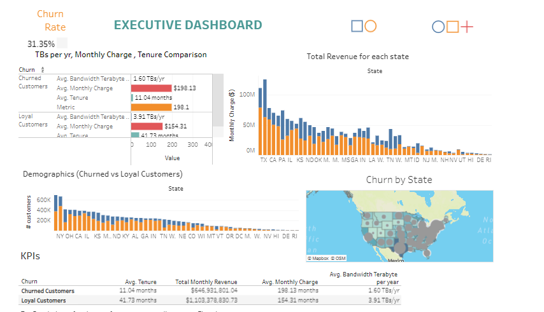
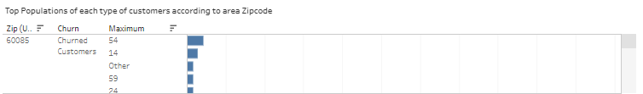
The churn rate at our company is 31.35% Telecommunications firms have annual turnover rates ranging from 10% to 67 %

Slide 3
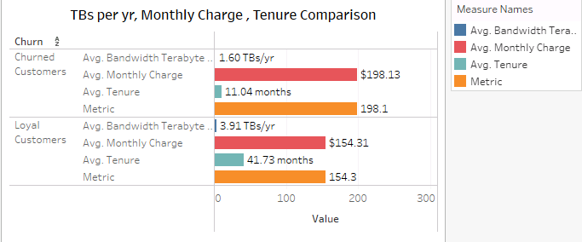


Slide 4
MOTIVATION FOR THIS OBJECT
USING TABLEAU IN A DATABASE CONTEXT. Most data in IT is in some database somewhere
pgAdmin will deal with our churn database. In the churn database – 5 tables were already pre-uploaded.
Contract.csv, customer.csv, job.csv, location.csv, payment.csv – The customer table had 10,000 rows.
Many other tables had information that are related to the primary customer table.
Additional external file– population_by_zip_2010.csv was found through Kaggle.com

Slide 5
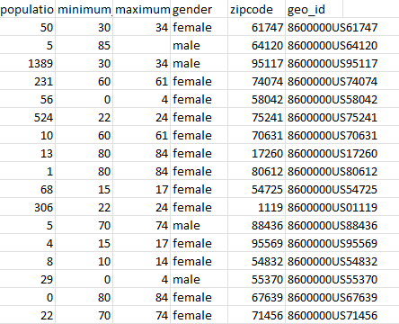
population_by_zip_2010.csv

Slide 6
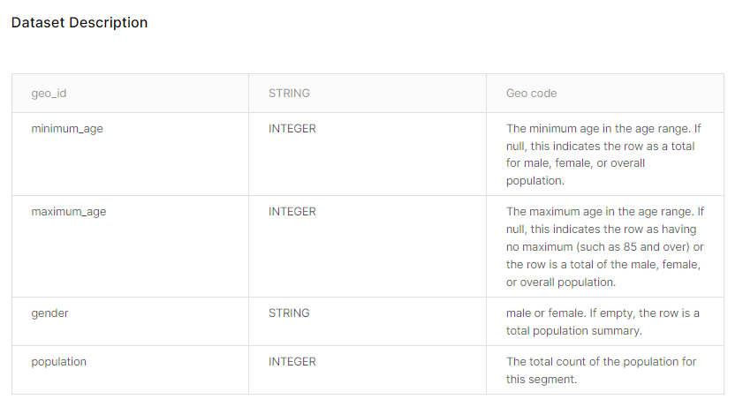

Slide 7
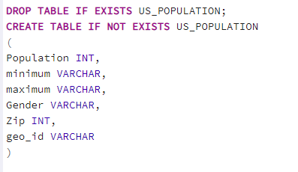
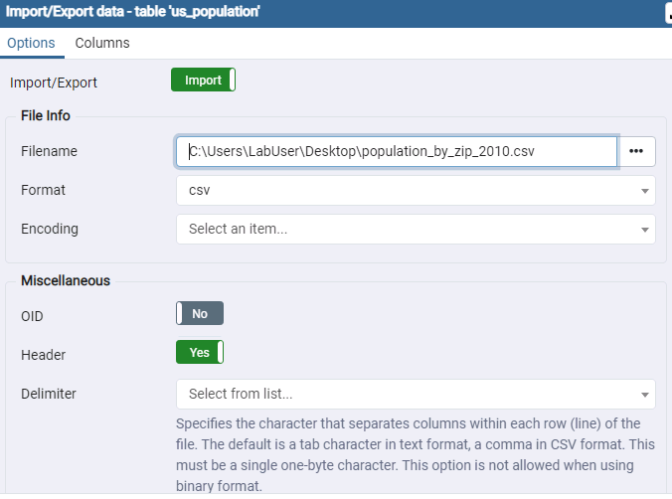
LOAD DATASET TO POSTGRESQL

Slide 8
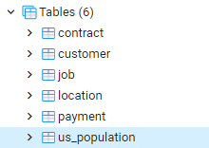
MUST JOIN US_POPULATION TABLE INTO THE OTHER PRE-UPLOADED TABLES ON THE CHURN DATABASE.
Working with primary and foreign keys can ensure referential integrity. Each foreign key must be paired with a primary key to ensure that cross-table references are always correct.

Slide 9
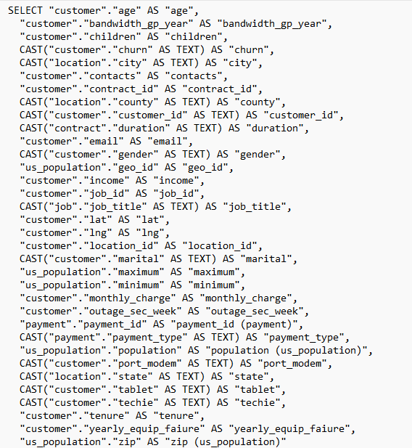
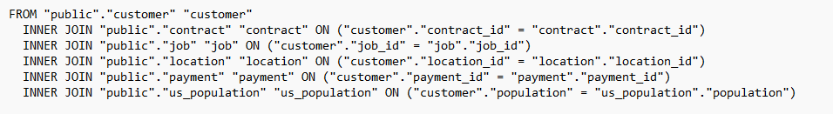
Joining each different table into one big table using the JOIN statement.

Slide 10
